Slide 1
5 Months of Art
By Jessica Barnes

Slide 2
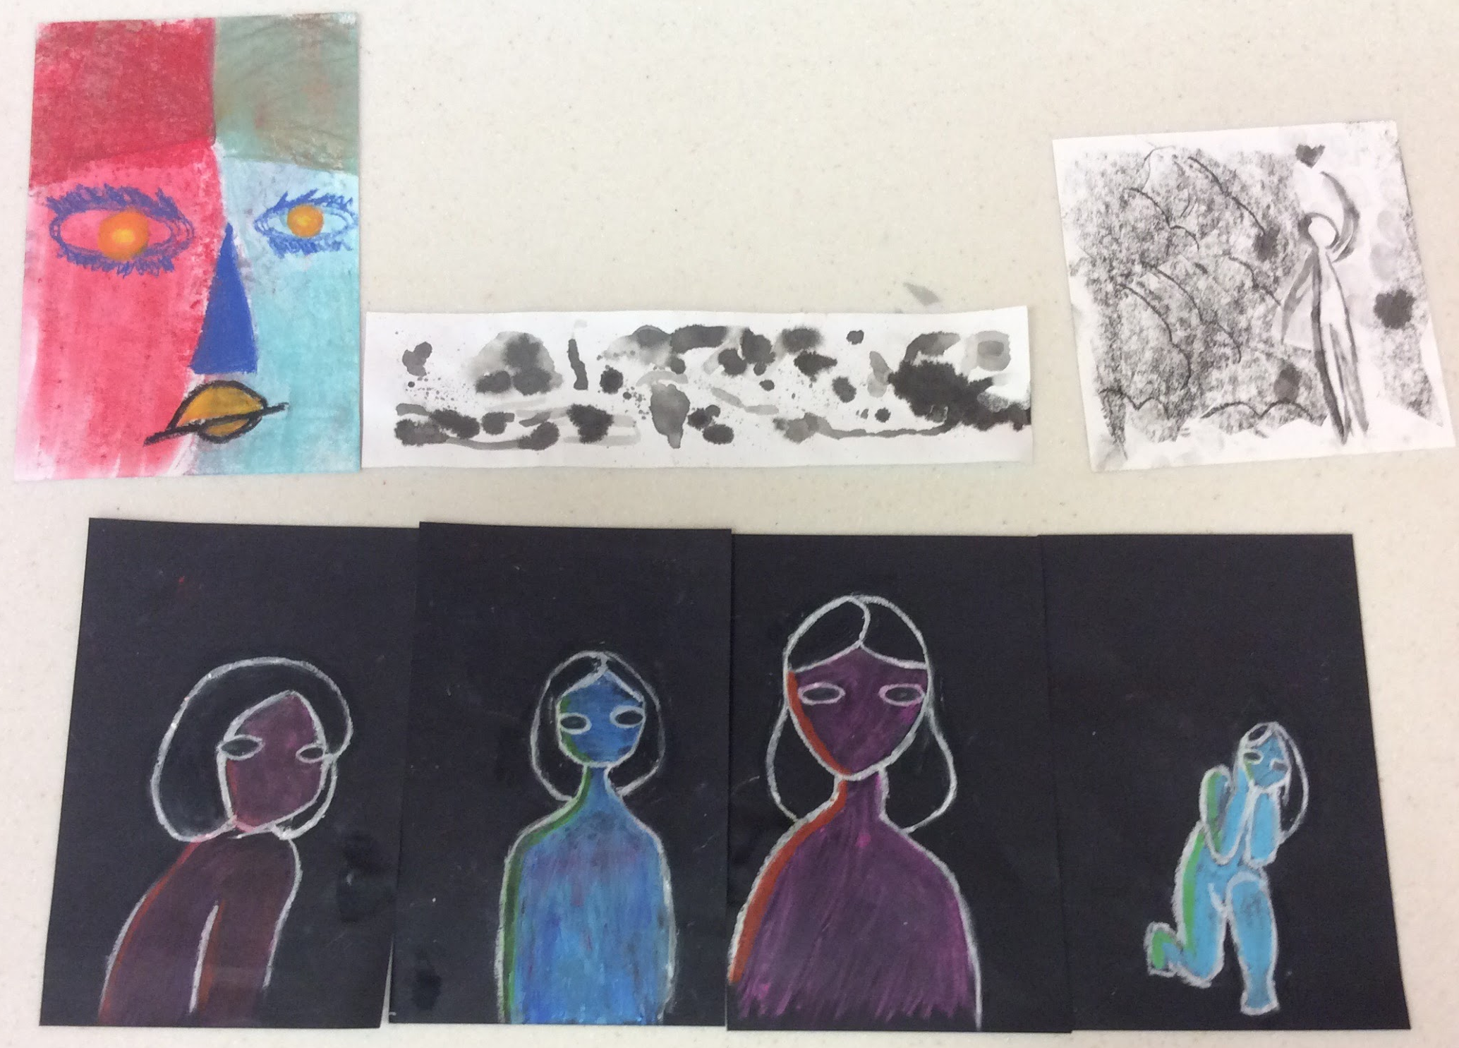
Risk Taking (How did taking risks or challenging yourself make you a better artist this semester? Explain how with examples from your work.)
I decided to step out of my comfort zone of sketching and work with other medias. My favorite thing to explore was the oil pastels. Because of this, I actually made a piece with oil pastels that ended up in the art museum. If I hadn’t explored the oil pastels, I would have never ended up in the art museum, so taking the risk worked out for me. I’ve also taken to sketching with oil pastels instead of graphite.

Slide 3
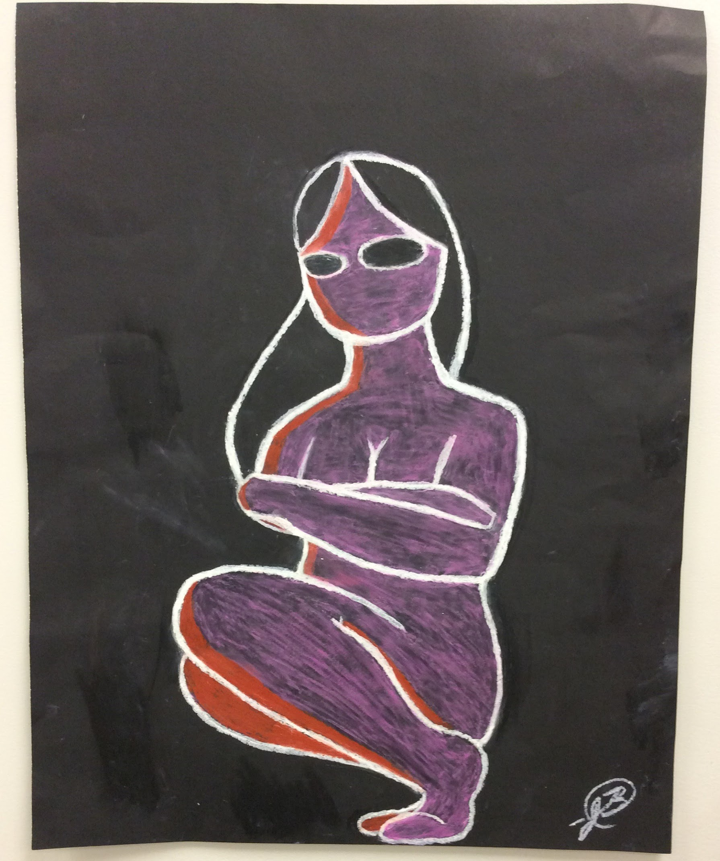
Modeling (What was your most successful project this semester? Describe the project and your work, then explain why this particular project was successful for you.)
My most successful project was a piece called “Modeling”. It was made with oil pastels and black poster board. I sketched out my ideas on paper and then moved the sketch onto the large poster board. Then I used oil pastels to finish the image. I submitted this project to the art museum for a teen expo, and got in. Not only that, but I tied for second place for the audience choice and won prizes. So to me, it was pretty successful.

Slide 4
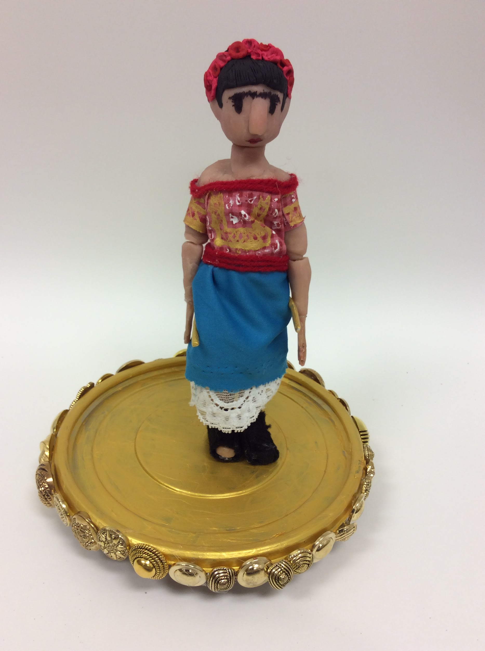
Frida (Discuss a project where you felt you overcame obstacles. What were those obstacles and how did you work through them to solve the problems?
Frida was my first wire and clay doll. I had trouble with the wire because it would keep slipping and I would have to make it tighter and tighter without ruining the frame. Then I had to sculpt the body around the wire and make it as anatomically correct as possible. Then I had to figure out how to make the clothes and have the doll stand up. This project took a lot of improve and reference images, but the result came out pretty good.

Slide 5
THANK YOU FOR A WONDERFUL SEMESTER MS. SCHUUMAN!!!

